Slide 1
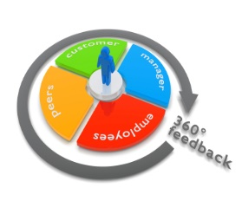
Post-Training
After-Session Actions
360º Feedback Report
360⁰ Program Schedule
Project Team Members’ names and email addresses sent to MRS | April 26, 2017
Project Team Members receive survey link (survey window opens) | May 1, 2017
Survey window closes | May 9, 2017
Report emailed to mentor and protégé | May 10, 2017
Schedule and conduct debrief with mentor Notify Mr. Haggerty of debrief completed | June 2, 2017 June 2, 2017
Mentors: Please alert your staff to complete the 360º Survey.
Protégés: Please mail the 360⁰ Report to your mentor.
6

Slide 2
Post-Training
After-Session Actions
Program Schedule
Actionable Item |  |  | Completion Date |  | Notes
Complete Project Planning Template for Leadership Project | Complete Executive Site Visit Summary and submit to Mr. Haggerty and MRS |  | March 10 | March 17 | Download Template from website
Mentor-Protégé Conference Calls begin |  |  | February 1
Submit Log Sheet tracking of conference calls to MRS |  |  | Two per month |  | Download Log Sheet from website
Mentor only conference call(s) |  |  | March 22
Protégé submits team members’ contact information to MRS |  | MRS administers 360⁰ Feedback Surveys to team members | April 26 | May 1 | See 360⁰ Schedule detailing when key components are due.
360º Feedback Reports completed and emailed to protégés by MRS |  |  | May 10 |  | See 360⁰ Schedule detailing when key components are due.
360º Feedback Report debrief session with Mentor |  |  | June 2 |  | Mr. Haggerty is notified by the protégé.
Complete Feedback Evaluation Surveys throughout the program |  |  | As Requested |  | MRS will administer.
Survey Protégés on impact of Mentoring Program 9 months into their first permanent assignment |  |  | ~ 9 months of first assignment |  | Use feedback to enhance future Mentoring Programs
7

